Slide 1
Reconstruction
The American Battlefield Trust

Slide 2
Inquiry Question:
What are the outcomes of the period known as Reconstruction?
Notes:
Ask students to create a hypothesis of the answer to this question. Have students either discuss in groups their ideas or as a class. Ask students how they produced those hypothesis.
In addition, consider what the term “Reconstruction” means.

Slide 3
Vocabulary
Reconstruction – A term used to describe the time in American history directly after the Civil War during which the South was “reconstructed” by the North after its loss in the war.
Republican Party – A political party created in the 1850s to prevent the spread of slavery to the territories. Eventually Republicans came to oppose the entire existence of slavery. Abraham Lincoln was the first Republican president. Very few Southerners were Republicans.
Democratic Party – The major political party in America most sympathetic to states rights and willing to tolerate the spread of slavery to the territories. Democrats opposed a strong Federal government. Most Southern men were Democrats before the War.
Notes:
More terms and definitions can be found on the “Glossary of Civil War Terms” page: https://www.battlefields.org/glossary-civil-war-terms

Slide 4
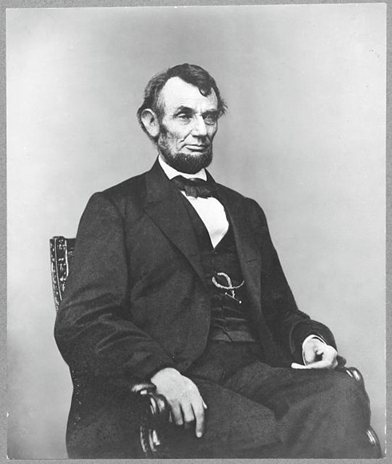
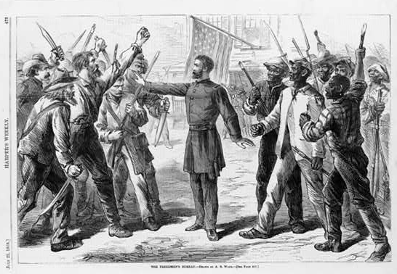
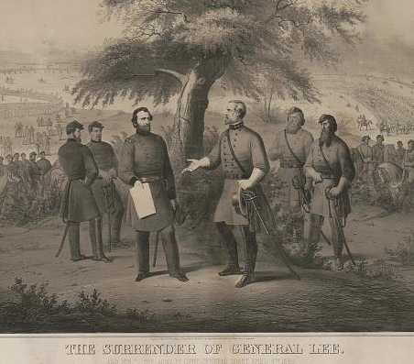
Part 1
1863-1865
Top Left: Abraham Lincoln. Top Right: Wood engraving of Freedmen’s Bureau. Bottom: The Surrender of General Lee. Source: Library of Congress

Slide 5
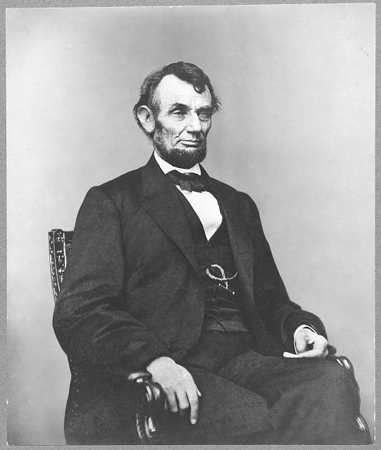
1863-1865
Lincoln’s War-Time Reconstruction
  Lincoln tries a few ideas for reconstruction, but these in are in-place during the war.
  Lincoln is trying to bring states back into the Union one at a time by offering easier reconstruction opportunities.
  He has no plan for reconstruction when the war ends.

Slide 6
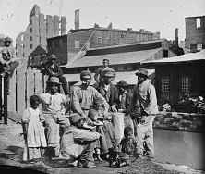
Early 1865
13th Amendment - December 6, 1865
Freedman’s Bureau Established by Congress – March 3, 1865
Civil War Ends - April 9, 1865
Lincoln Assassinated - April 14, 1965
Freedmen in Richmond, VA, April 1865. Source: Library of Congress
Notes:
Read the 13th Amendment
First of 3 Reconstruction Amendments to help give African Americans legal standing as voting citizens
Freedmen’s Bureau
Help African Americans for immediate needs after the Civil War:
Mission statement: “direct such issues of provisions, clothing, and fuel, as he may deem needful for the immediate and temporary shelter and supply of destitute and suffering refugees and freedmen and their wives and children”
Was supposed to last only 1 year, it lasted until 1872
Assassination of President Lincoln
With the assassination of Lincoln, many were worried about Reconstruction
Lincoln was a figure that both Northerners and Southerners trusted – believed he was the best candidate for a smooth transition

Slide 7
1863-1865
Watch Eric Foner explain Lincoln’s ideas on reconstruction.
https://www.youtube.com/watch?v=6xg2njAEOdE

Slide 8
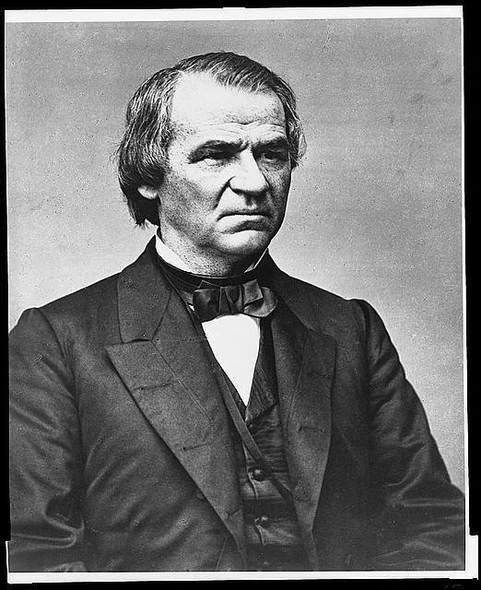
Part 2
Presidential Reconstruction
Andrew Johnson. Source: Library of Congress
Notes:
With the

Slide 9
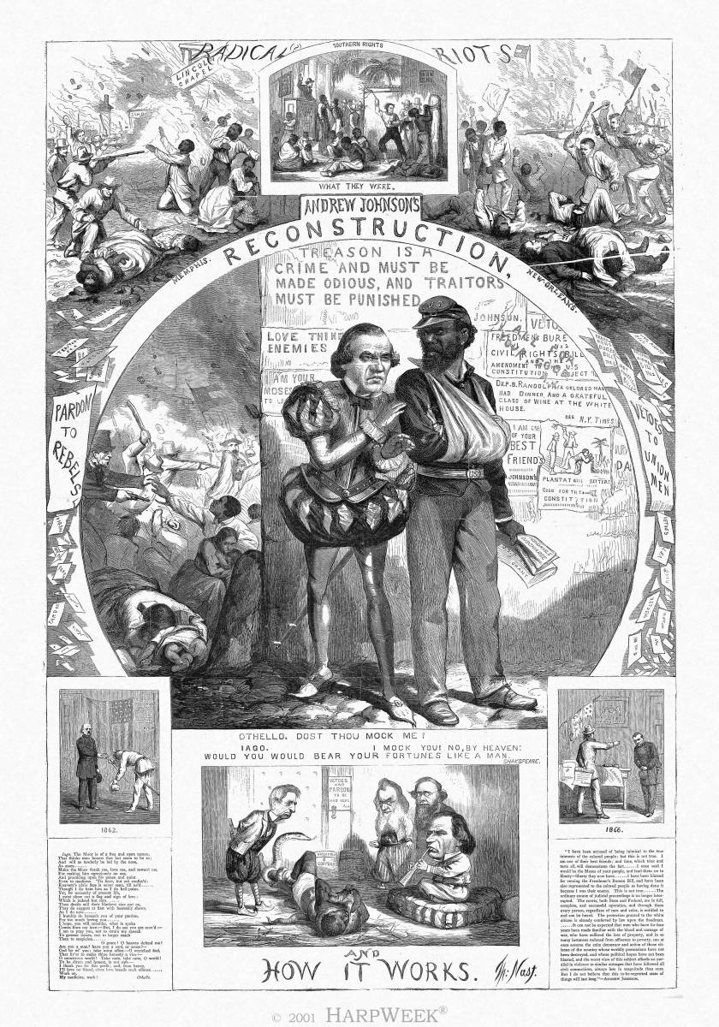
1865- Presidential Reconstruction
Vice President Andrew Johnson is Inaugurated - April 15, 1865
Congress in Recess from - April-December 1865
Johnson’s Reconstruction Plan
Black Codes Emerge
Ku Klux Klan Formed
  A terrorist organization founded by former Confederates in Tennessee is created to terrorize African-Americans and those who support their equal rights.
Andrew Johnson’s Reconstruction and How it Works by Thomas Nast. Source: Library of Congress
Notes:
With the election of President Johnson, Reconstruction took a different turn.
Johnson gave a full pardon to all White Southerners and allowed them to reclaim, previously, confiscated land
This land was originally confiscated since these White Southerners took up arms against the United States and was, under Lincoln’s Reconstruction, supposed to be parceled out to African Americans to began small farms
Johnson individually pardoned many high-ranking Confederate generals and politicians and allowed them to take positions of power
These politicians created Black Codes that limited African American freedom
At the same time the Ku Klux Klan, a terrorist group, was established which physically assaulted and intimidated African Americans.

Slide 10
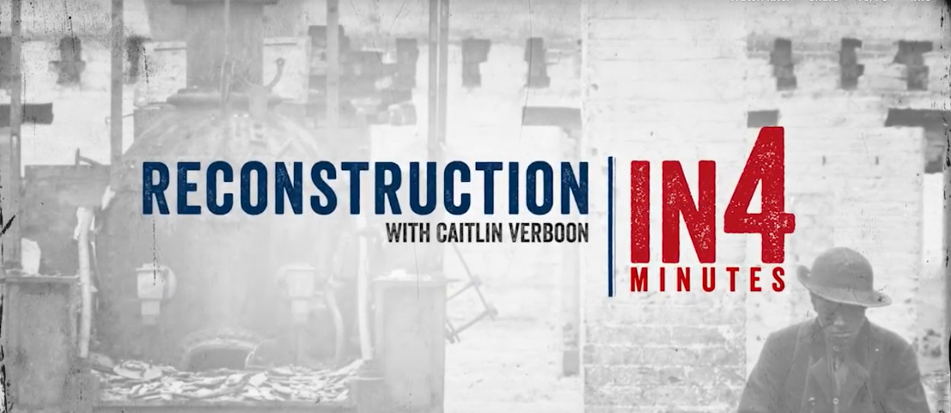
1865- Presidential Reconstruction
Watch from 0:00-1:30
Notes:
Watch from 0:00 to 1:30 (the rest of the video will be watched later in the powerpoint)
https://www.battlefields.org/learn/videos/reconstruction-after-civil-war

Slide 11
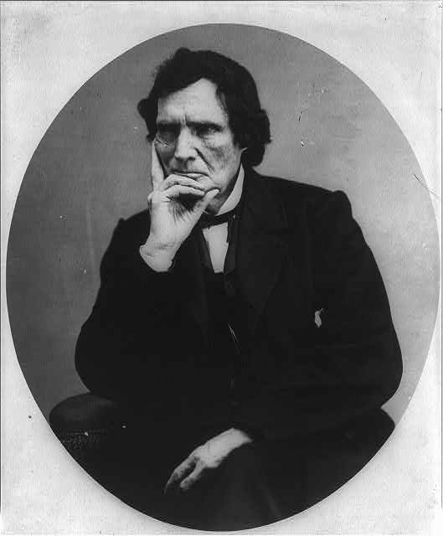
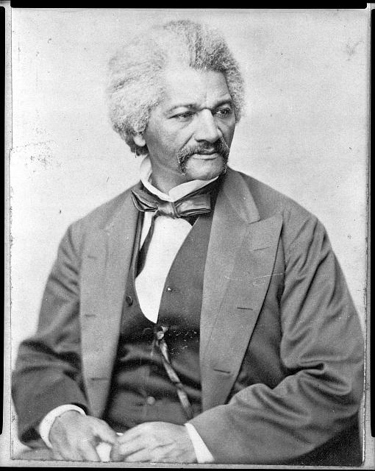
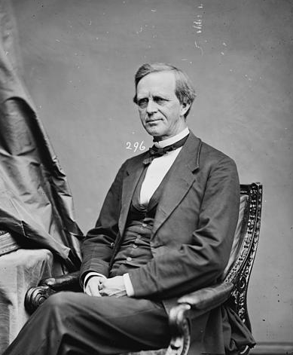
Part 3
Congressional Reconstruction
Top left: Thaddeus Stevens, Top right: Frederick Douglass, and Bottom: Lyman Trumbull. Source: Library of Congress

Slide 12
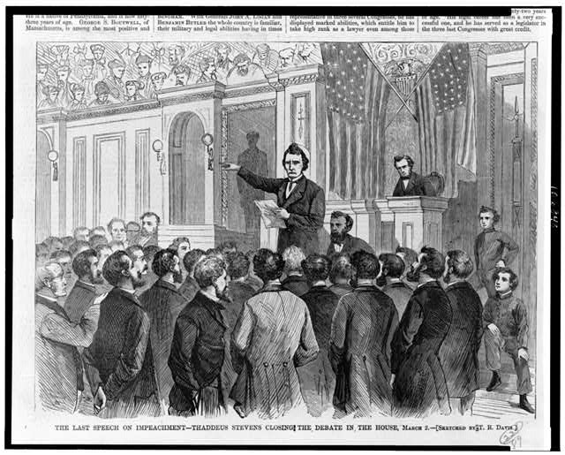
1865-1868 Congressional Reconstruction
Congress returns - December 1865
Joint Committee on Reconstruction Established – December 13, 1865
Freedman’s Bureau Act of - 1866
Civil Rights Act of - 1866
Reconstruction Bill - 1867
Johnson Impeached – February 1868
14th Amendment Ratified – July 1868
The Last Speech on Impeachment. Source: Library of Congress
Notes:
Joint Committee on Reconstruction
Listened to testimony from Southern States/lawmakers and the Freedman’s Bureau to determine if Reconstruction was beneficial to all parties involved, i.e. Southerners and freedmen
Wanted more laws to help freedmen in Southern states → were not approved
Helped draft and propose the 14th amendment
Freedman’s Bureau Act of 1866
President Johnson originally vetoed the continuation of the Freedmen’s Bureau on the grounds that it interfered with States’ Rights, gave preference to certain groups more than others, and cost the federal government too much money
Congress overrode the president’s veto, but the Bureau was chronically underfunded
Civil Rights Act of 1866
Precursor to the 14th Amendment that established African Americans as citizens and defined what citizenship was
President Johnson vetoed this bill, but Congress overrode his veto – it was officially ratified in 1870
Reconstruction Bill
Led to “Radical Reconstruction” because many thought that neither justice nor healing was properly secured after the Civil War
This bill required states to ratify the 14th amendment before being readmitted to the Union
Johnson Impeachment
Johnson tried to remove Edwin M. Stanton, Secretary of War, from office and replace him. Congress believed this action violated the Tenure of Office Act
He narrowly avoided conviction and remained in office

Slide 13
1865- Presidential Reconstruction
Watch from 1:30-3:17
Notes:
Watch 1:30-3:17 (the rest of the video will be watched later in the powerpoint)
https://www.battlefields.org/learn/videos/reconstruction-after-civil-war

Slide 14
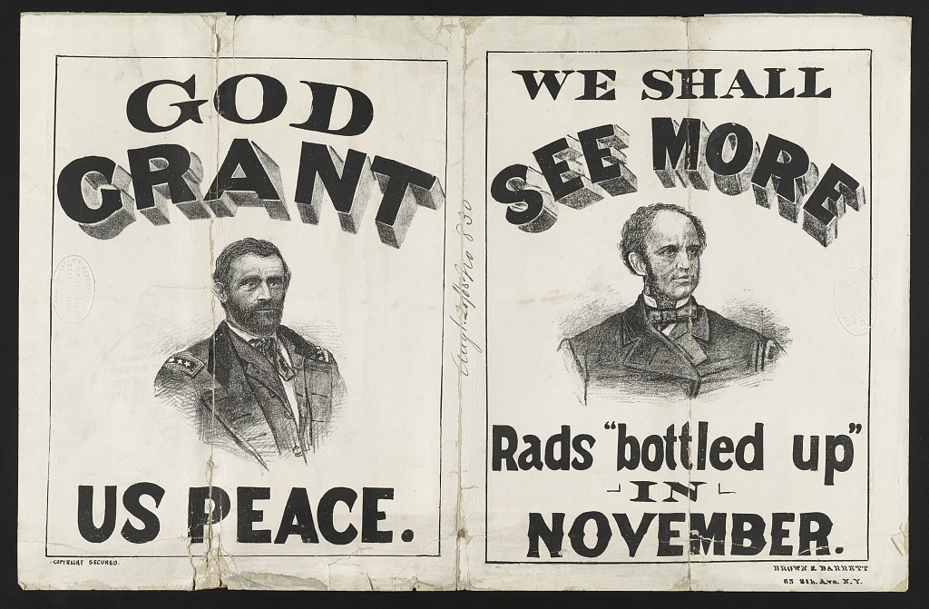
1868-1872
Ulysses S. Grant Elected President – inaugurated March 4, 1869
15th Amendment Ratified – February 3, 1870
Enforcement Acts – 1870 & 1871
Grant re-elected – second inauguration March 4, 1873
Campaign sign for the 1868 Presidential campaign. Source: Library of Congress
Notes:
15th Amendment
Last Reconstruction Amendment
Constitution prohibits he federal government and each state from denying a citizen the right to vote based on that citizen’s “race, color, or previous condition of servitude”
Enforcement Acts
They were criminal codes which protected African-Americans’ right to vote, to hold office, to serve on juries, and receive equal protection of laws
Allowed the federal government to intervene if states were not upholding these rights

Slide 15
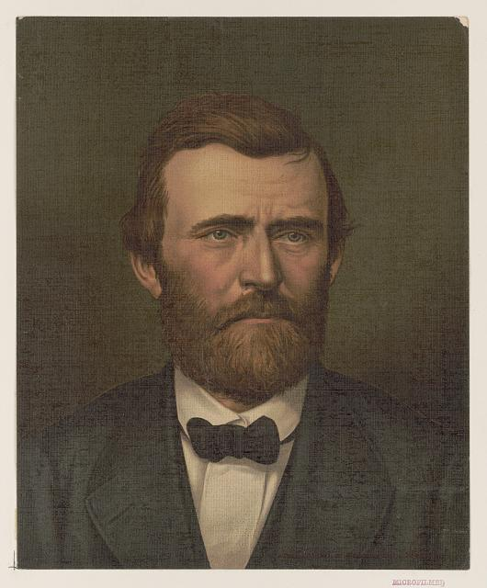
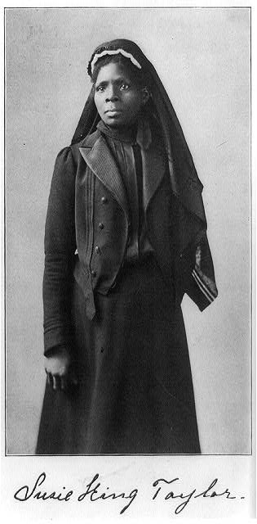
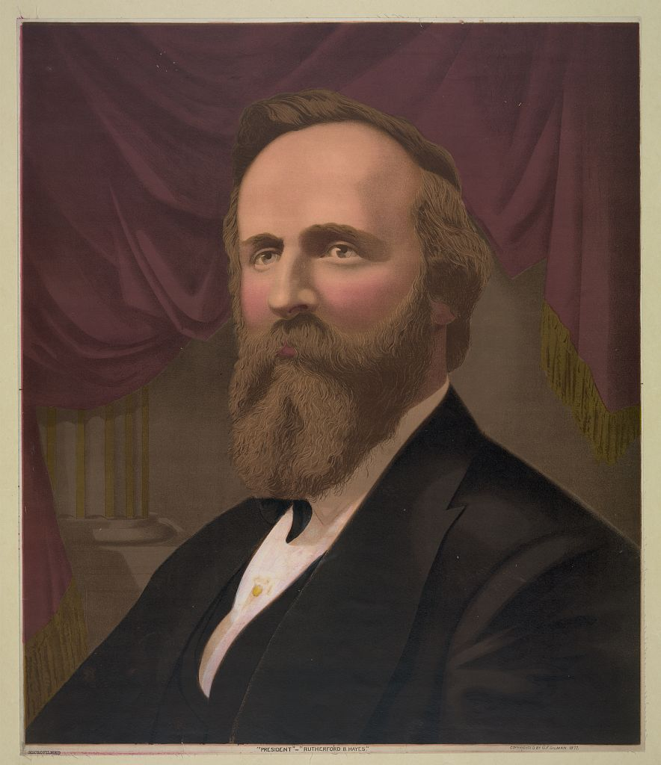
Part 4
End of Reconstruction
Top Left: Ulysses S. Grant. Top Right: Susie King Taylor. Bottom: Rutherford B. Hayes. Source: Library of Congress

Slide 16
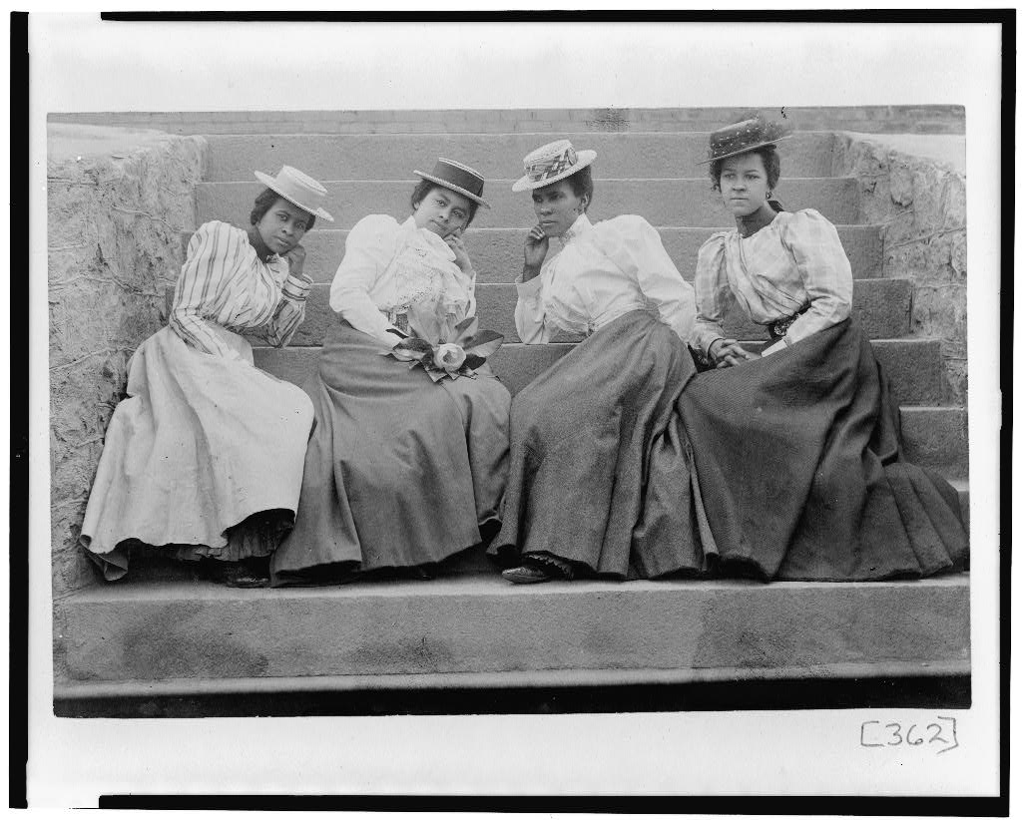
1873-1877
Nation falls into economic depression - 1873
Democratic Party gain Control of the Senate and House of Representatives - 1874
Civil Rights Act of 1875
Rutherford B. Hayes Elected President – 1876
Removal of Federal Troops from the South - 1877
Voter suppression of African Americans commence in the late 1870s
African American women seated on steps of building at Atlanta University, Georgia. Between 1850 and 1900. Source: Library of Congress
Notes:
Panic of 1873
Catalyst was the failure of Jay Cooke and Company, an investment banking firm, principle banker of the Northern Pacific Railroad and of wartime government loans → allowed people to get bonds and loans for the first time
Failure → New York Stock Exchange closes for 10 days, factories default, foreclosures are widespread → President Grant is blamed
Democratic Party Rise
Depression was blamed on Grant and the Republican Party → switch to Democratic
Republican focused heavily on Reconstruction initiatives, while the Democrats did not
Reconstruction officially ended in 1877
Civil Rights Act of 1875
Last federal civil rights law enacted until the 1950s
Aim to “protect all citizens in their civil and legal rights” but had no means to enforce this legislation
Removal of Federal Troops
Unwritten Compromise of 1877 – Hayes said he would remove troops from South, which allowed him to get enough votes to become president
Troops were protecting Republican governments in South → removal equals the governments becoming Democratic and ostracizing Black Republicans
Voter Suppression
Reemerged when Democratic Governments gained control of the South

Slide 17
1865- Presidential Reconstruction
Watch from 3:17-End
Notes:
Watch from minute 3:17 to the end
https://www.battlefields.org/learn/videos/reconstruction-after-civil-war

Slide 18
What Do You Think About This?
How do you see the impacts of the Reconstruction period today?
Consider…
  Education and Employment
  Government Representation
  Justice
  Civil Rights
  Economics
  Regional Differences

Slide 19
Inquiry Question:
What are the outcomes of the period known as Reconstruction?
Notes:
Discuss with the students on whether their hypothesis were correct or not. Discuss what the students learned from their primary and secondary sources.

